Slide 1
PAINT APPLICATION
N.Krishna Santhoshi
1602-19-733-107
M.Srividya Reddy
1602-19-733-111

Slide 2
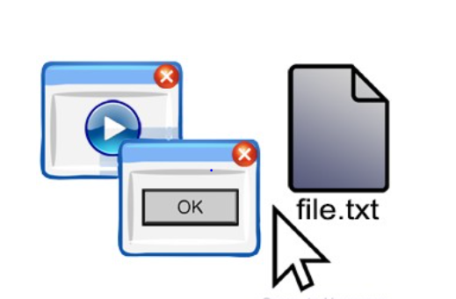
GRAPHICAL USER INTERFACE
The graphical user interface (GUI) is a form of user interface that allows users to interact with electronic devices through graphical icons
Simply put, GUIs help your users do things within your device, platform, program, or app without needing to type commands or know the coding behind the action.
Some specific examples are:
Moving a document into the “Trash” folder on your desktop
Clicking on an icon to launch an application
Moving files from one folder to another

Slide 3
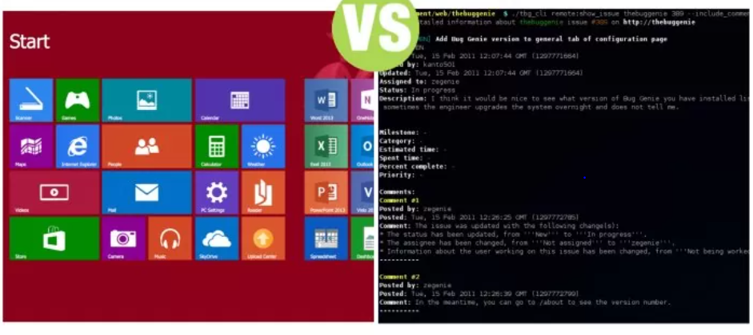
GUI ALLOWS THE USER TO INTERACT WITH GRAPHICAL ELEMENTS WHEREAS COMMAND LINE ALLOWS THE USER TO INTERACT USING COMMANDS

Slide 4


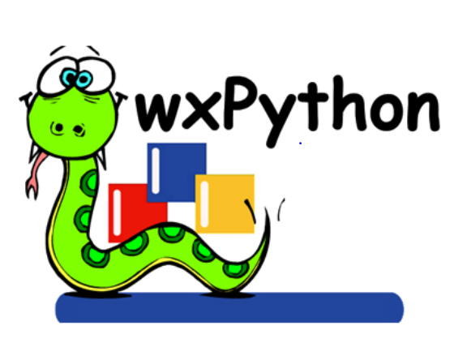

PYTHON LIBRARIES FOR GUI
1.Kivy
2.Qt
3.wxPython
4.Tkinter

Slide 5
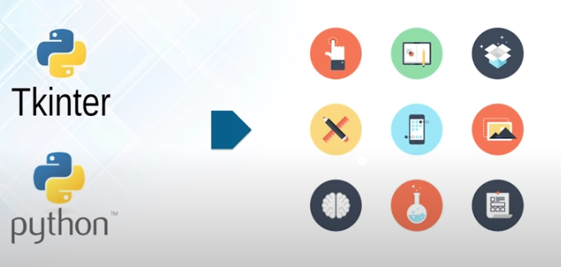
Tkinter:
Tkinter in python GUI Programming is a standard Python GUI library. It gives us an
object-oriented interface to the Tk GUI Toolkit
Out of all the GUI methods, tkinter is the most commonly used method. Out of all the GUI methods, tkinter is the most commonly used method.

Slide 6
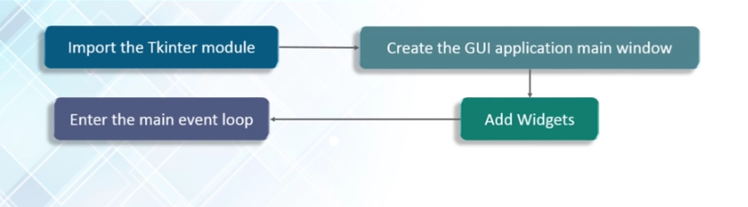
TO CREATE A TKINTER APP:
Import the Tkinter module.
Create the GUI application main window.
Add one or more widgets to the GUI application.
Enter the main event loop to take action against each event triggered by the user.

Slide 7
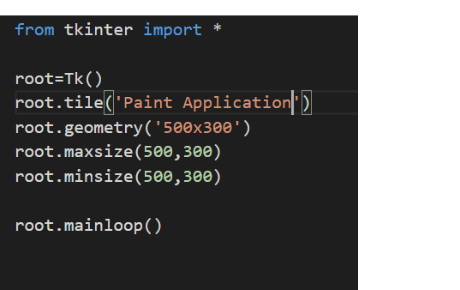
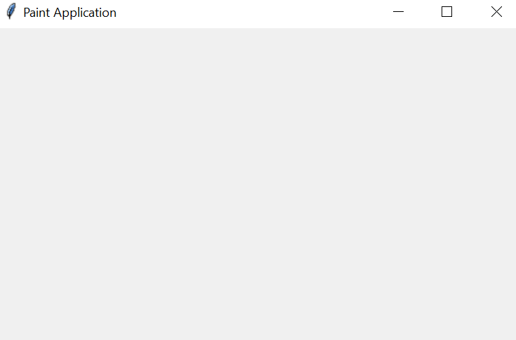
Creating a main window:

Slide 8
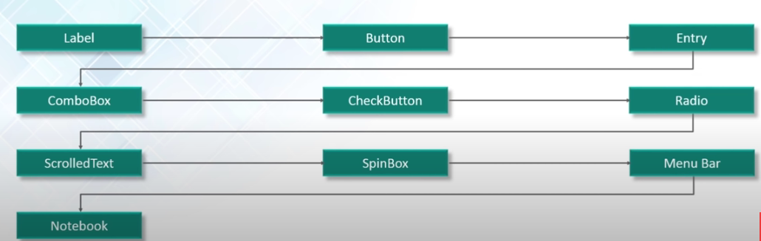
Widgets:
Widget is an element of Graphical User Interface (GUI) that displays/illustrates information or gives a way for the user to interact with the OS.
Commonly used widgets in tkinter:

Slide 9
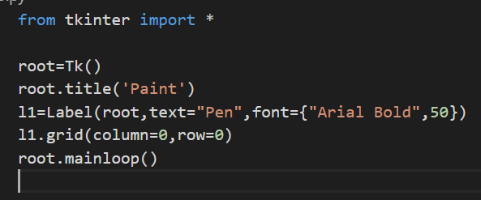
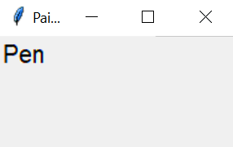
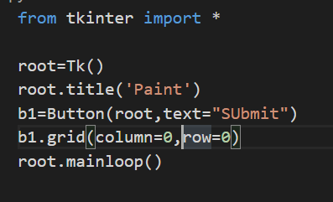
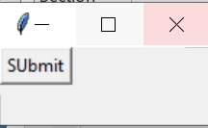
LABEL WIDGET:
It is used to print text and images on the main window.
BUTTON WIDGET:
It is used to add buttons to your application

Slide 10
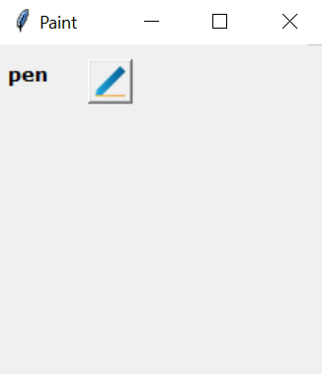
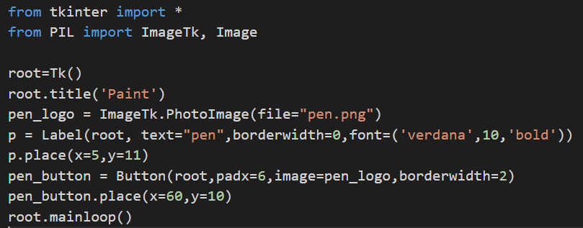
Adding a image to Button:
Images can be added using PhotoImage method

Slide 11
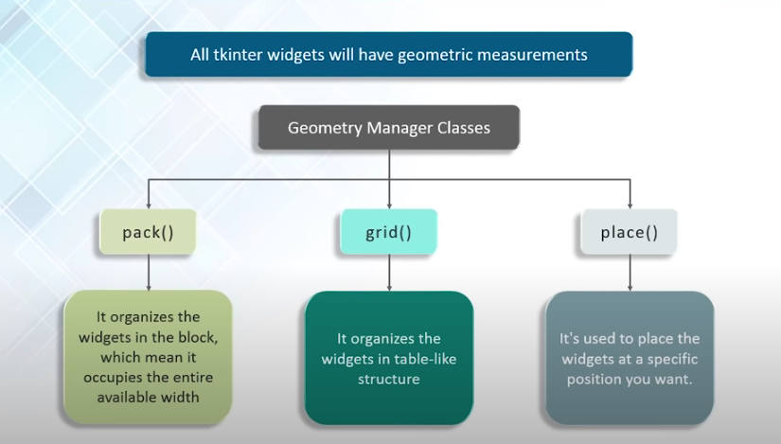
LAYOUT MANAGEMENT IN TKINTER
To organize our widgets, we use specialized non-visible objects called layout managers.
Tkinter has three layout managers:
1.Pack
It places the widgets according to the absolute positioning
2.Grid
it places the widgets in the form a 2D matrix
3.place
It places the widgets according to the co-ordinate axis.

Slide 12
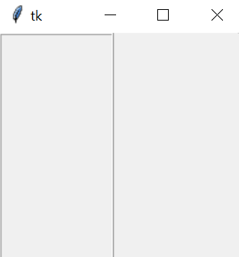
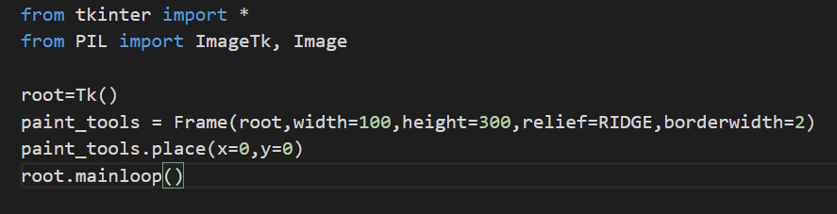
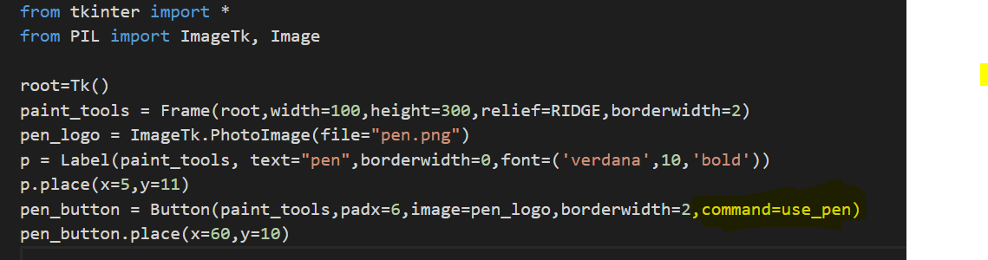
FRAME:
It is used to divide the main window into several parts. Frames are aligned using pack() method
BINDING FUNCTIONS:
Calling functions whenever an event occurs refers to a binding function

Slide 13
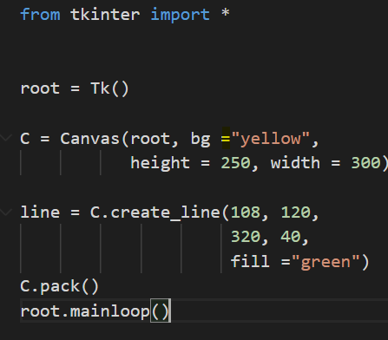
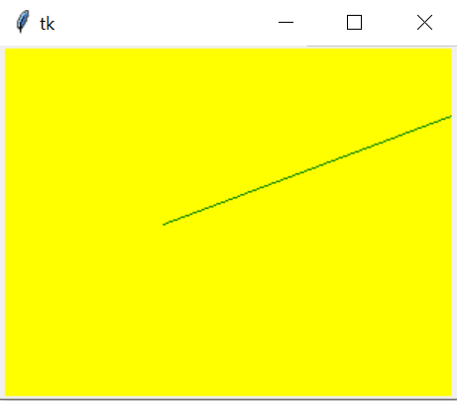
CANVAS IN TKINTER:
The Canvas widget lets us display various graphics on the application. It can be used to draw simple shapes to complicated graphs. We can also display various kinds of custom widgets according to our needs.
Drawing a line using Canvas widget:

Slide 14
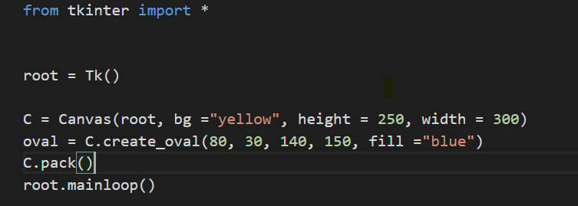
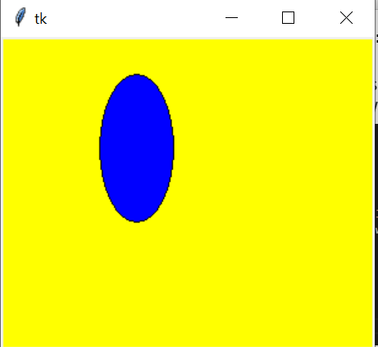
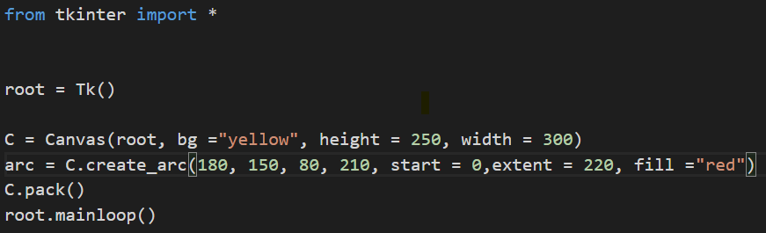
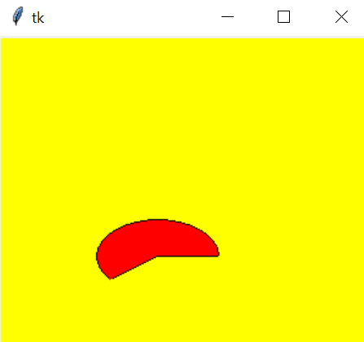
Drawing an oval using Canvas widget:
Drawing an arc using canvas widget:

Slide 15
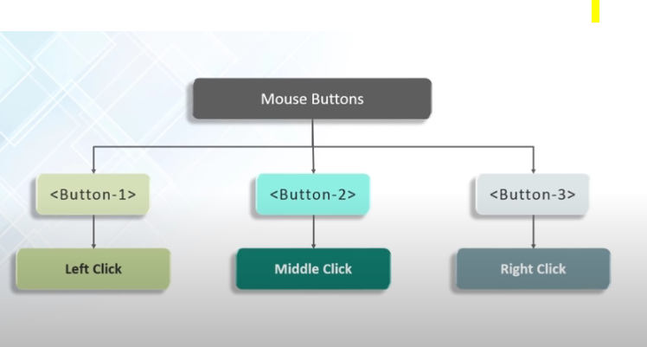
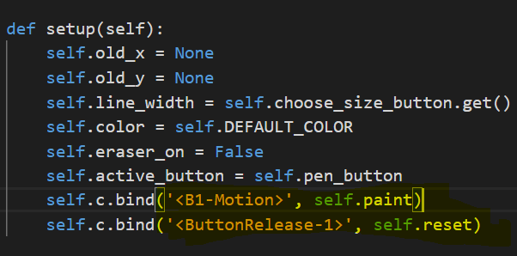
EVENT HANDLING:
Mousemove, mouseover, clicking ,scrolling are some events
Here we bind the <B1-Motion> with paint function. Whenever there is a left click/B1-Motion then it automatically triggers paint function. Paint function uses the previous location of the event and present location and draws a line between them. We bind the Button-release with reset function. Reset function places the previous location of the event to None.

Slide 16
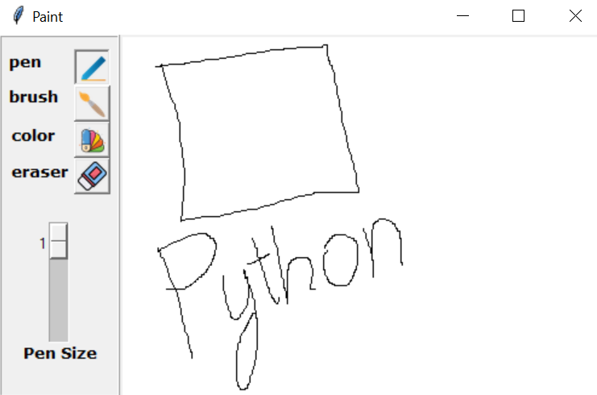
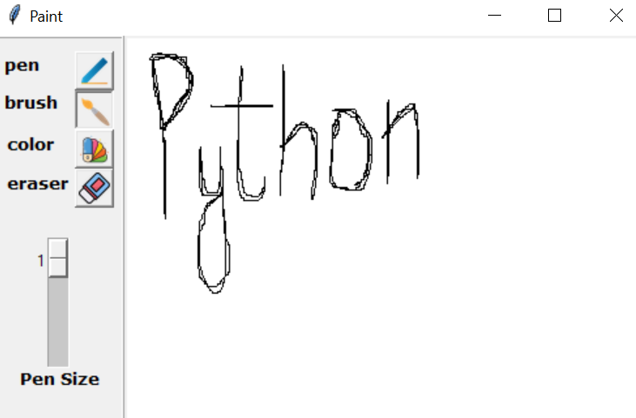
OUTPUT SCREENSHOTS:
USING A PEN: USING A BRUSH:

Slide 17
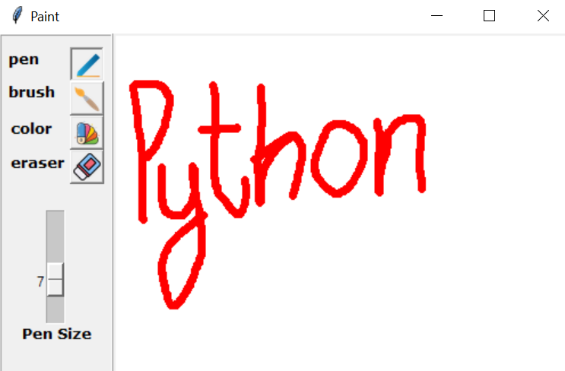
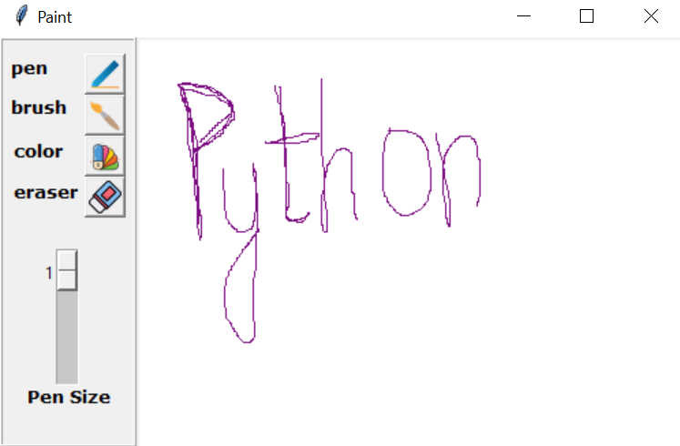
PENSIZE:7 COLOUR:VOILET

